Slide 1
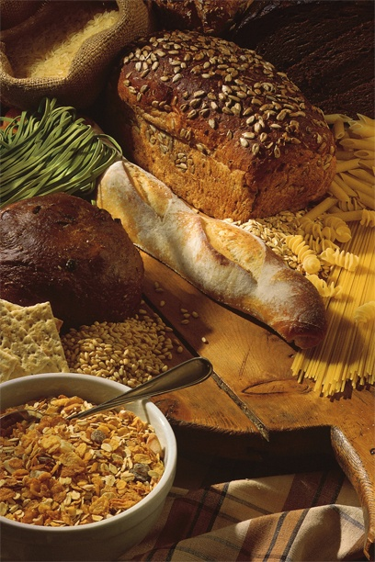
The Wheat You Eat
How It’s Grown and
Made Into Our Food
Notes:
Today, we are going to talk about one of our favorite foods. Something that you may not even think about as a favorite food, because so many different things are made out of it.

Slide 2
How Much Wheat Do You Eat?
Did you have cereal or toast for breakfast?
Did you have a sandwich for lunch?
Do you like to eat spaghetti, cookies or macaroni and cheese?
Do you LOVE pizza?
Notes:
Think about what you have eaten today. Did you have cereal or toast for breakfast? Did you have a sandwich for lunch? Do you like spaghetti, cookies and macaroni and cheese? Do you love to eat pizza?

Slide 3
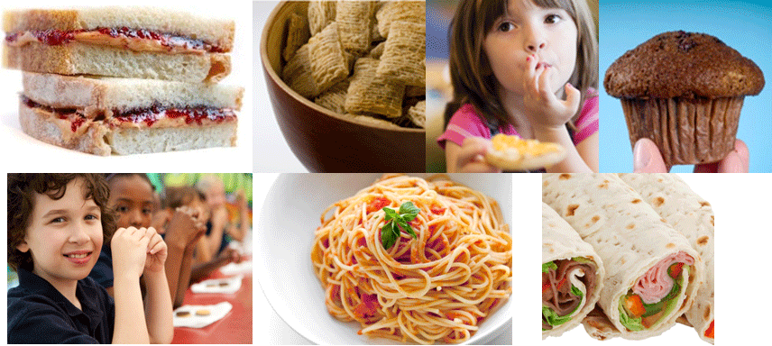
Then You Eat Wheat!
Wheat is the basic ingredient in many of our
favorite foods.
Notes:
If you do, then you like wheat! Wheat is a basic ingredient in so many of our foods. Can you think of some other examples?

Slide 4
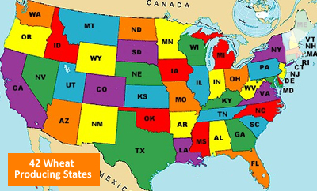
Did You Know?
42 states in the U.S. grow wheat
Does our state grow wheat? If so, where?
Alabama
Arizona
Arkansas
California
Colorado
Delaware
Florida
Georgia
Idaho
Illinois
Indiana
Iowa
Kansas
Kentucky
Louisiana
Maryland
Michigan
Minnesota
Mississippi
Missouri
Montana
Nebraska
Nevada New Jersey
New Mexico
New York
North Carolina
North Dakota
Ohio
Oklahoma
Oregon
Pennsylvania
South Carolina
South Dakota
Tennessee
Texas
Utah
Virginia
Washington
West Virginia
Wisconsin
Wyoming
Notes:
Wheat is a very popular crop in the United States. Forty-two of our fifty states grow wheat. Do we grow wheat in (Name of state)? Do you know where?

Slide 5
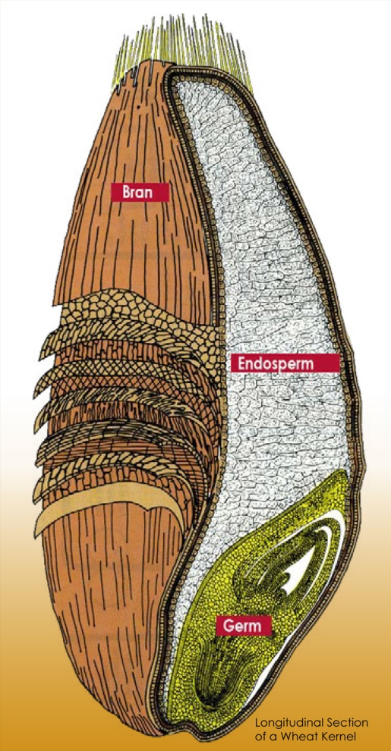
Did You Know?
Wheat is a grain that people have been growing and eating in many ways, for thousands of years.
Each kernel of wheat has three parts:
The outer layer is called the BRAN
The middle layer is called the ENDOSPERM
The inner layer is called the GERM
Notes:
Here are some interesting things about wheat. First, it is what is called a Grain food. And it is a very old food. People have been growing and eating wheat for thousands of years. Wheat grows in kernels, and each kernel has three parts. The outer layer of a kernel is called the bran; the middle layer of a kernel is called the endosperm and the inner layer is called the germ of the kernel.

Slide 6
Did You Know?
Each of those 3 kernel parts has nutrients that make our bodies strong:
FIBER makes you feel full after you eat
PROTEINS and CARBOHYDRATES give you energy
VITAMINS and MINERALS make you strong & healthy
Notes:
In that small kernel are many nutrients that help us grow and become strong. There is FIBER, that makes you feel full after you eat. There are PROTEINS and CARBOHYDRATES that give you energy. And there are VITAMINS and MINERALS that make you strong and keep you healthy.

Slide 7
Did You Know?
Whole- grain foods are made using the whole kernel (all 3 parts) of the grain.
Many foods we eat, like bread, pasta, crackers, and cereal, can be made with whole wheat. This means you are eating all 3 parts of the grain, and getting many important nutrients.
Notes:
Some foods are called Whole Grain Foods, like those made out of whole wheat flour. These are made using all three parts of the kernel. What were those called again? That’s right – the bran, the endosperm and the germ.
7

Slide 8
Did You Know?
Wheat food products can also be made from
enriched flour.
This means they are made from flour that
has been ground using endosperm only.
Many vitamins and minerals lost by not using the
bran and germ are added back in. This is called
“enriched.”
Enriched grains provide essential B vitamins
which help us maintain a healthy body and
increase energy.
Notes:
Other Wheat Foods are Enriched. This means they are made from flour that has been ground using endosperm only. Vitamins and minerals lost by not using the bran and germ are added back in as part of the milling process.
8

Slide 9
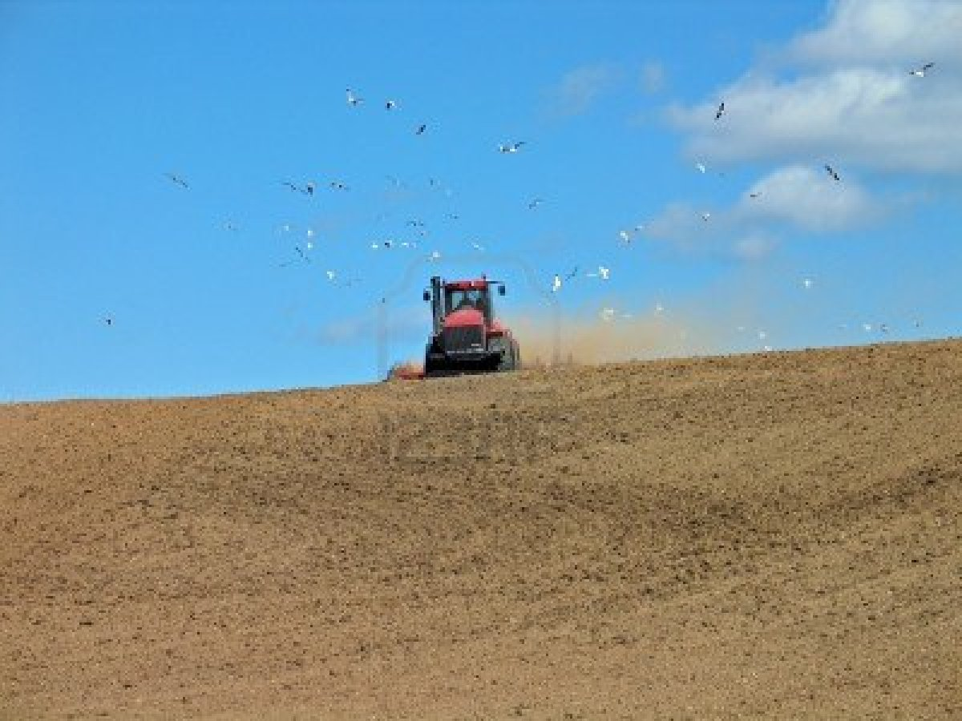
How Wheat Grows
First, the soil is worked. Today, some farmers use no-till planting, which does not disturb the soil, reduces soil erosion, uses less fuel and increases the amount of nutrients.
Notes:
So now let’s talk about how wheat grows. Usually, it grows on very large farms. Wheat farmers there start by working the soil. Today, some farmers use no-till planting. This does not disturb the soil, increasing the amount of nutrients which helps crops grow. It also uses less fuel and decreases soil erosion which is good for our environment.

Slide 10
How Wheat Grows
Then the seeds are planted. Fertilizer may be
added to help the seeds grow.
Notes:
Then they plant the seeds. They really work to take care of the seeds so that they will flourish.

Slide 11
How Wheat Grows
The plants emerge from the ground and depend
on nutrients from the soil and rainfall to grow
and develop.
Notes:
The wheat plants emerge from the ground and, nourished by nutrients in the soil and watered by the rain, they grow and develop.

Slide 12
How Wheat Grows
Farmers monitor the wheat fields throughout
the growing season for disease and pest issues
and work to protect the crop.
Notes:
During this important time, farmers keep a close watch on the crop, working to protect the wheat plants so they grow healthy and strong.
12

Slide 13
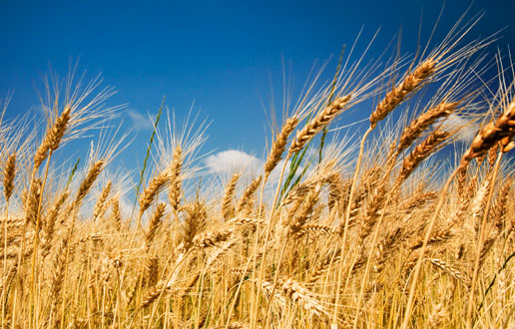
How Wheat Grows
When the wheat stems are tall and begin to“nod,”
or bend over, and the kernels are ripe and dry, it is
time to harvest. They are a beautiful golden color.
Notes:
Soon the wheat grows tall and strong. It’s a beautiful golden color in the fields at harvest time. The wheat kernels need to be ripe and dry for harvest.

Slide 14
How Wheat Grows
Farmers use a big machine called a “combine”
to harvest the stalks of wheat.
Notes:
The name “combine” comes from its combining separate operations that make up harvesting – reaping, or cutting the stalks, and separating out the kernel, or edible part.
14

Slide 15
What Happens Next?
When the combines fill up, they load the wheat
into trucks.
Notes:
When the wheat is harvested from the field, it is placed in trucks for transporting.

Slide 16
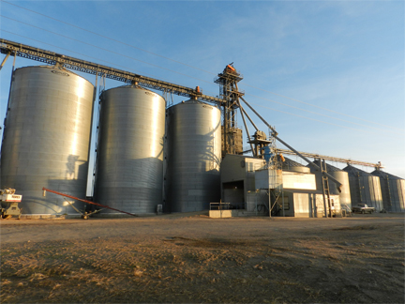
What Happens Next?
The harvested wheat is stored in enormous grain
bins, until it is moved to the next stage, the mill.
Notes:
The trucks deliver the wheat to specialized buildings called grain elevators for storage until time to take it to the mill, where it is turned into flour.
16

Slide 17
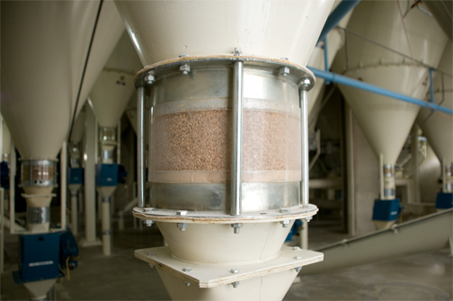
How Wheat is Milled
In the milling process, the wheat is
Cleaned
Separated
Ground
And may be enriched.
Notes:
The milling process takes the grain to flour. It is cleaned, separated, ground and then may be enriched with vitamins, to replace those that came out during the processing.

Slide 18
How Wheat Grows
Wheat can be planted in the spring or the fall.
It is an annual which means it must be planted each year, for each crop.
It takes about 3 months for wheat to grow from seed to harvest in the summertime, and longer over the wintertime.
Notes:
Wheat is what is called an “annual” crop. This means it must be planted again every year, or for every crop. Depending on the class or type of wheat, it is planted in either the spring, growing throughout the summer, or in the fall, with the growing season in the winter. In the summer, it takes about 3 months for wheat to grow from seed to harvest. It takes longer for winter wheat to grow tall enough to be harvested. Why do you think that is?

Slide 19
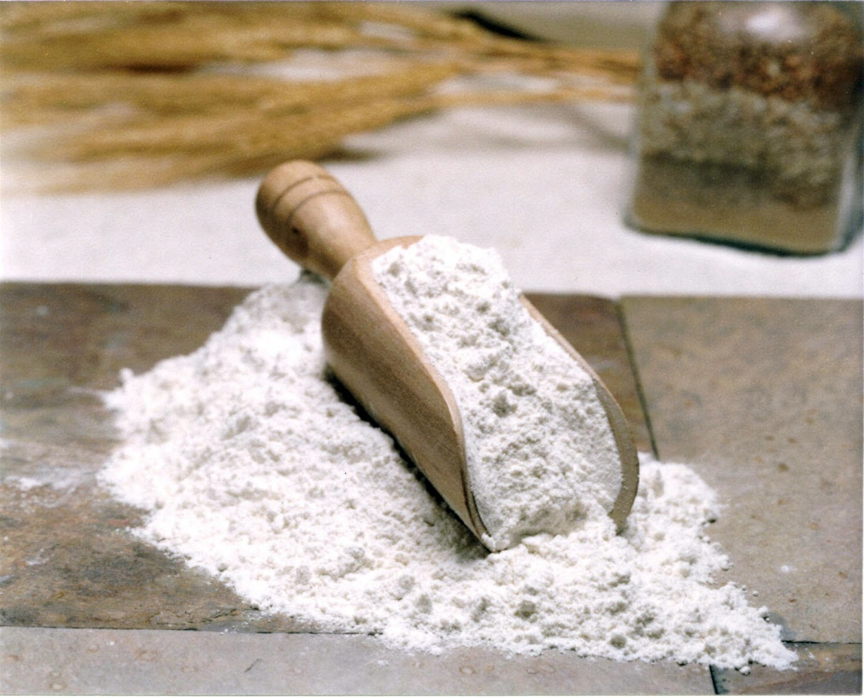
How Wheat is Milled
And made into either whole wheat or white flour.
Notes:
This is what ground wheat, or white flour, looks like. Whole wheat flour is slightly more brown. You’ve probably seen this in your own kitchen at home.
19

Slide 20
Wheat Becomes Our Food!
And from there, the flour is delivered to food
companies to combine it with other ingredients
and made into all kinds of foods we like to eat!
Notes:
From the mill, wheat flour is sold to food companies that make it into all kinds of good things to eat.

Slide 21
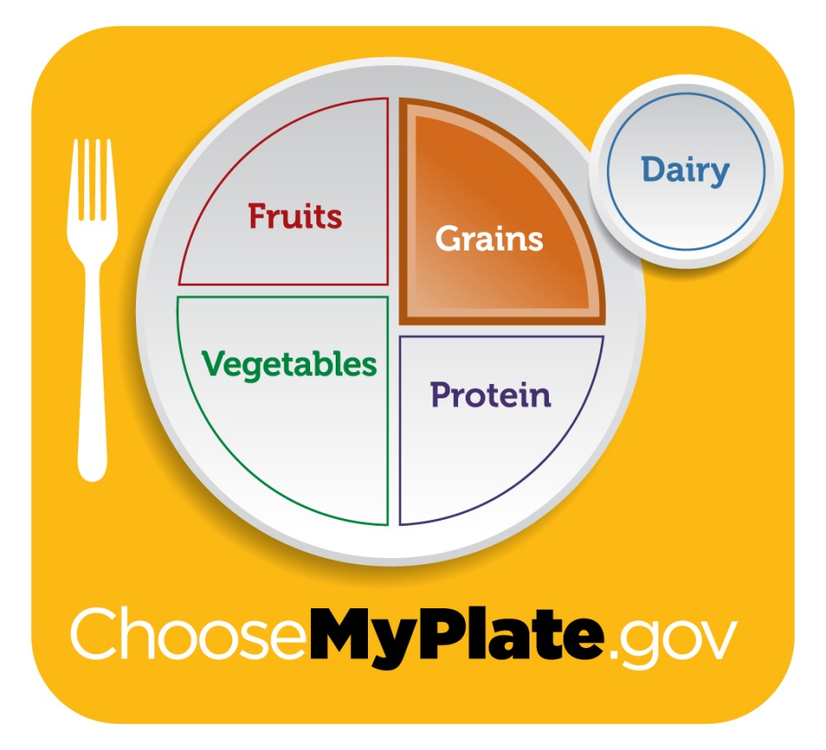
How Much Wheat to Eat?
Grains like wheat are so important to our diet
that the nutrition experts say kids should eat
five or six servings
every day! Three of
those servings should
be whole grains.
Notes:
Did you know that wheat products are an important part of our diet? Do you know how much wheat you should be eating? The answer is five or six servings of a wheat product every single day. And half of those – maybe three servings – should be whole grains.

Slide 22
How Much Wheat to Eat?
A serving is:
A Slice of Bread
A Cup of
Ready to Eat
Cereal
Half a Cup
of Pasta or
Cooked Cereal
Notes:
Here are some good ways to remember what a “serving” is. It’s one piece of bread, one cup of your favorite ready to eat cereal, or a half of a cup of pasta or cooked cereal. Remember, you need a total of 5-6 servings, every single day!
22

Slide 23
Wheat Gives Us
FIBER for
digestive health
CARBOHYDRATES
for energy
B-VITAMINS & IRON
that helps keep our
bodies healthy
Notes:
Let’s talk again about why wheat is important to eat. It gives us fiber that is good for our digestive health, carbohydrates that provide energy, and minerals like iron and important B-vitamins that keep our bodies healthy.

Slide 24
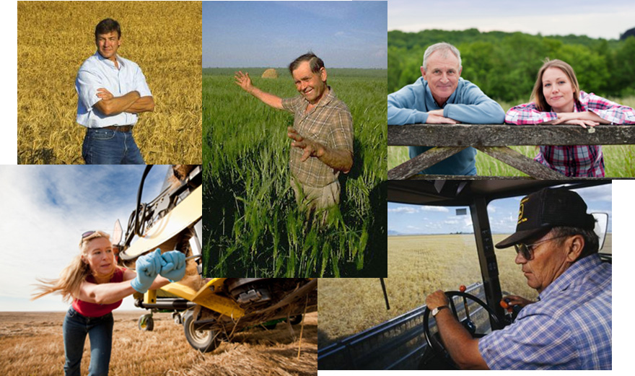
Thanks To Our Wheat Farmers!
Notes:
We owe a big thanks to America’s wheat farmers, who grow the nutritious wheat we eat!

